Slide 1

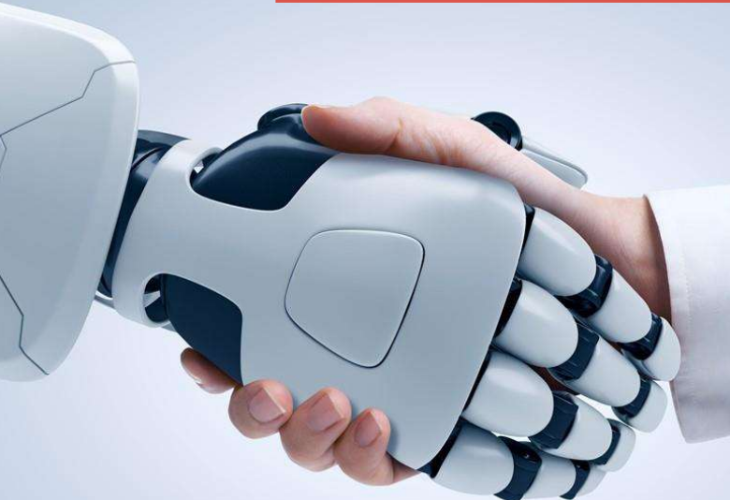
AI in Product Management

Slide 2
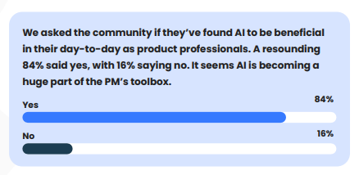

Slide 3
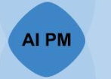
AI Product Management
AI product managers are the ultimate collaborators with cross-functional teams of data scientists, engineers, designers, and marketers.
They craft AI products that meet customer expectations and align with the organization’s broader objectives.

Slide 4
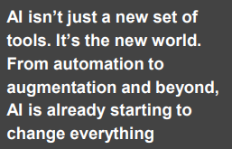
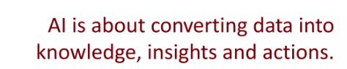
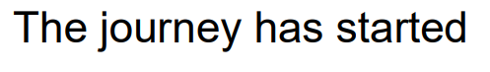

Slide 5
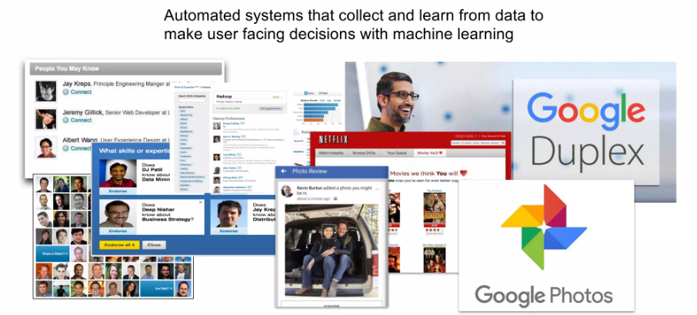

Slide 6
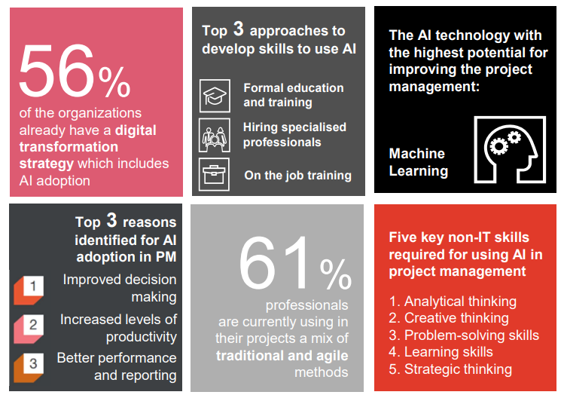


Slide 7
Levels of AI
Level 1:Manual Process
Level 2: Human intervention with AI assistance
Level 3:AI Driven with Fine tuning
Level 4:Fully Automated by AI

Slide 8
Understanding AI In PM

Slide 9
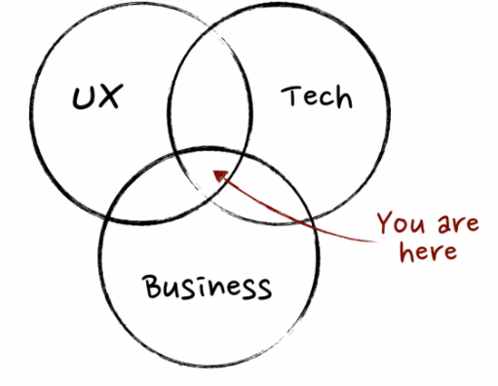

Slide 10
How to use AI in Product World

Slide 11
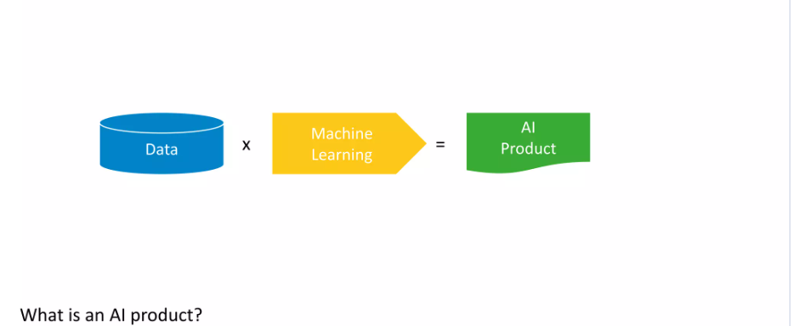

Slide 12
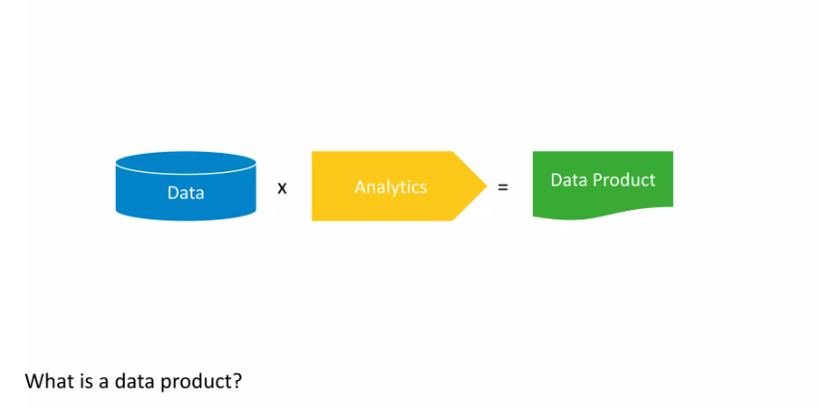

Slide 13
Making AI work

Slide 14
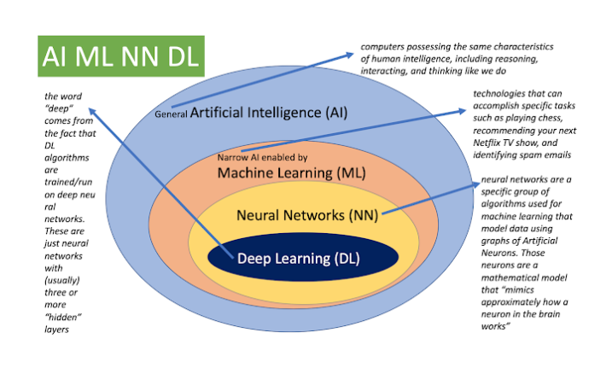

Slide 15
Data?

Slide 16
Types of Analytics

Slide 17
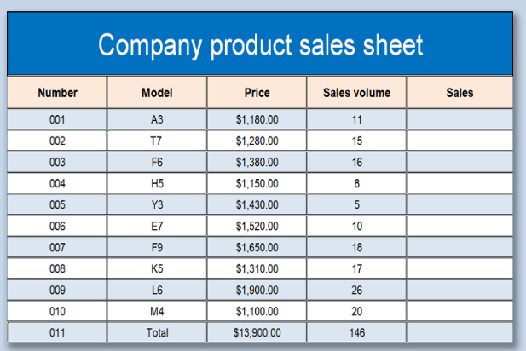
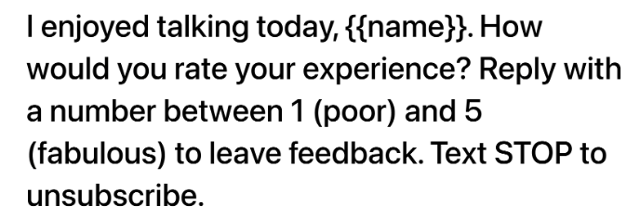

Slide 18
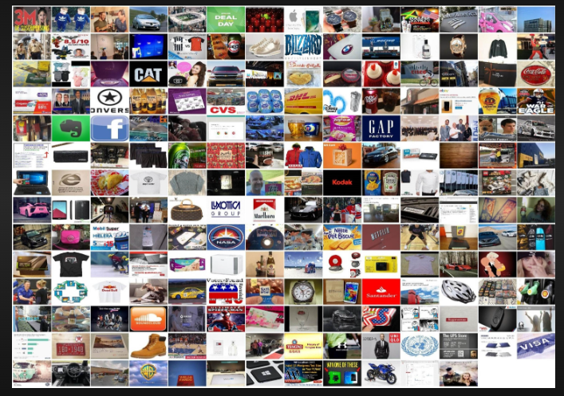
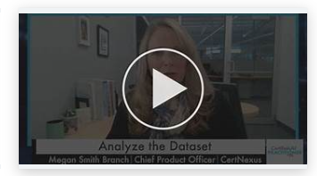
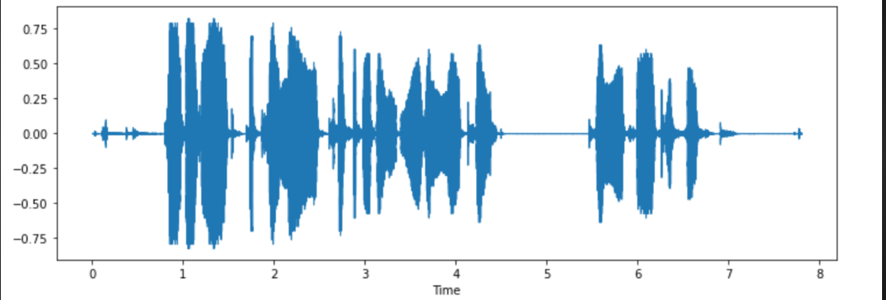

Slide 19






Slide 20
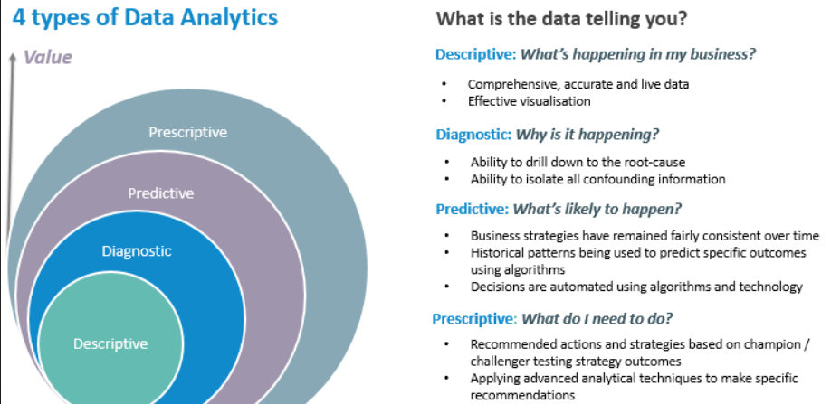

Slide 21
Scenario
TechTrendz is a leading retailer specializing in electronics and gadgets. Over the years, the company has accumulated vast amounts of data related to sales, customer behavior, inventory, and marketing campaigns. Let's follow TechTrendz through their analytics journey.

Slide 22
Analytics?
TechTrendz's analytics team starts by analyzing sales data from the previous year.
They create reports and dashboards to visualize key performance indicators (KPIs) such as total revenue, sales by product category, and geographical sales distribution.
Through descriptive analytics, they gain insights into which products are top sellers, peak sales periods, and popular customer demographics.

Slide 23
Analytics?
After identifying a decline in sales for a particular product line, TechTrendz's analysts dive deeper into the data.
They perform root cause analysis to understand the factors contributing to the decline.
Through diagnostic analytics, they uncover issues such as pricing competitiveness, insufficient marketing efforts, or changes in consumer preferences, enabling them to formulate corrective actions.

Slide 24
Analytics?
Armed with insights from descriptive and diagnostic analytics, TechTrendz's team leverages predictive analytics to forecast sales for the upcoming quarter.
By analyzing historical sales trends, seasonality, economic indicators, and market trends, they develop predictive models to anticipate demand for various products.
These forecasts help the company optimize inventory management, pricing strategies, and resource allocation.

Slide 25
Analytics?
With predictive models in place, TechTrendz's executives turn to prescriptive analytics to determine the best course of action.
Using optimization algorithms, they simulate different scenarios to maximize profitability, minimize costs, or optimize marketing ROI.
For example, they may use prescriptive analytics to decide on promotional strategies, inventory replenishment schedules, or pricing adjustments, ultimately driving business growth and competitiveness.

Slide 26
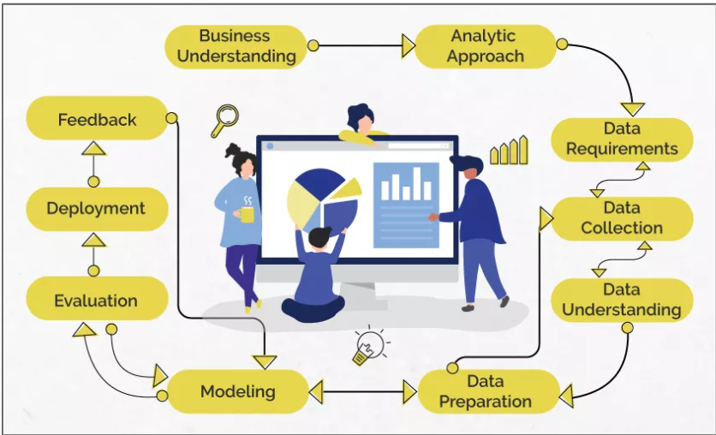
Data Science/Machine Learning

Slide 27
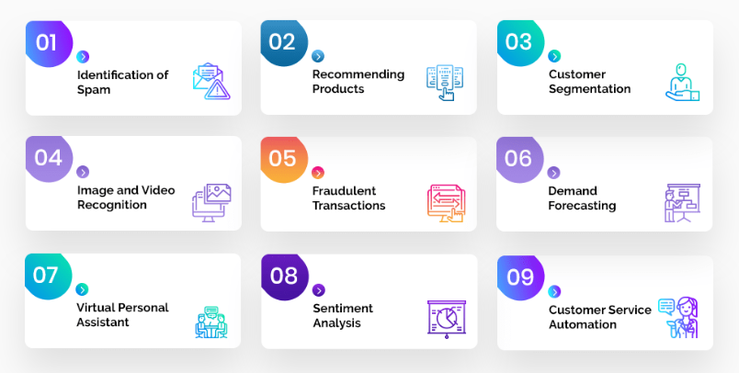
Problem Statement

Slide 28
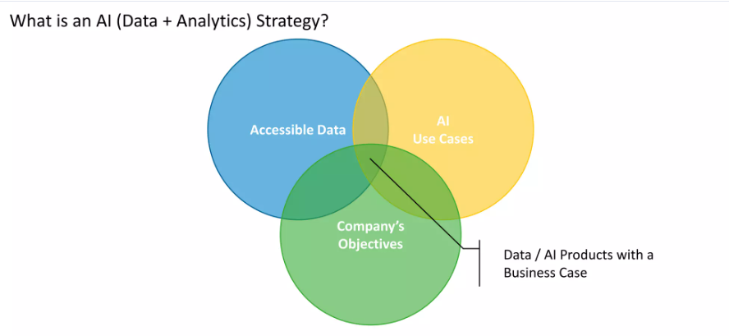

Slide 29
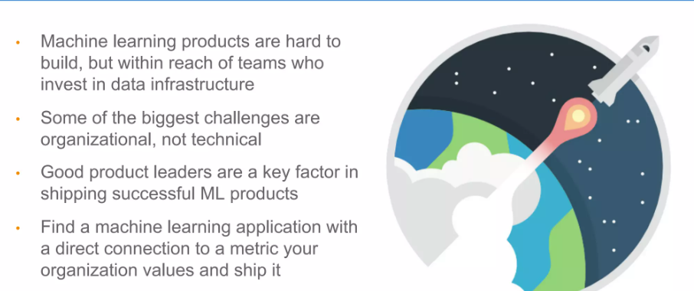

Slide 30
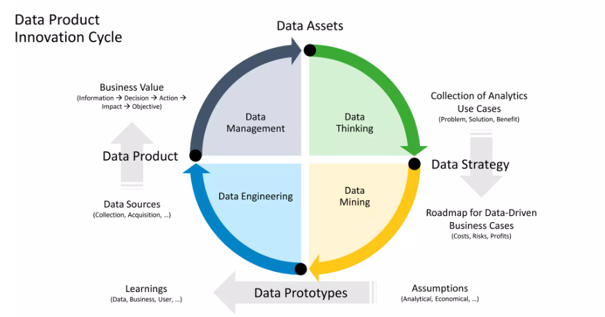

Slide 31
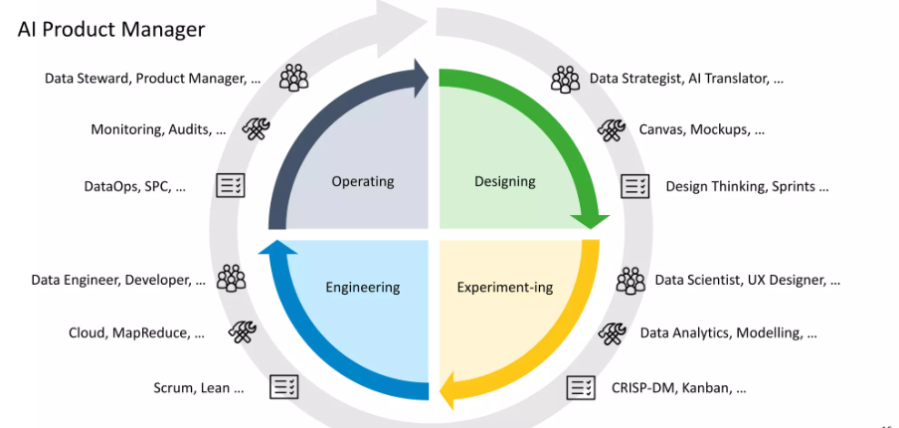

Slide 32
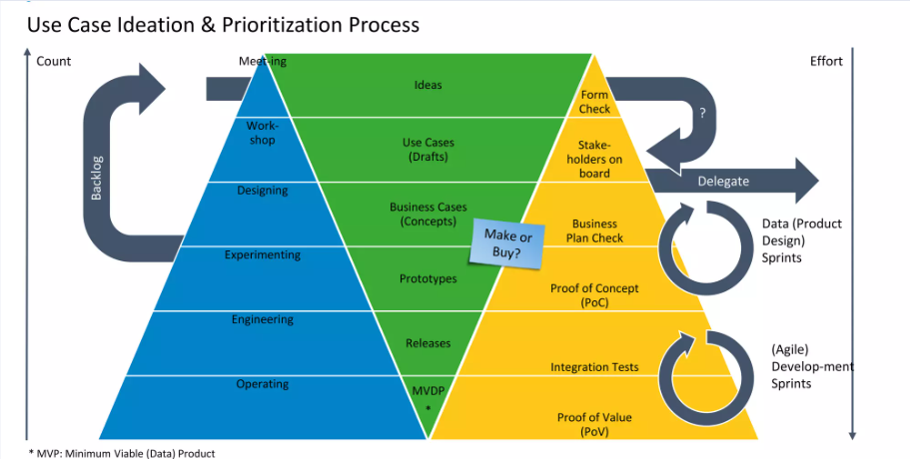

Slide 33
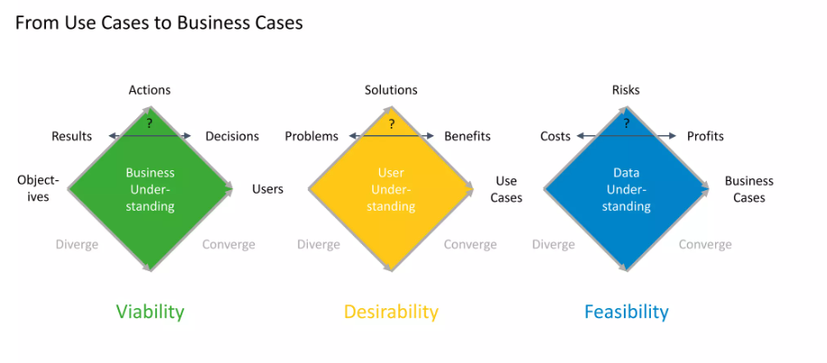

Slide 34
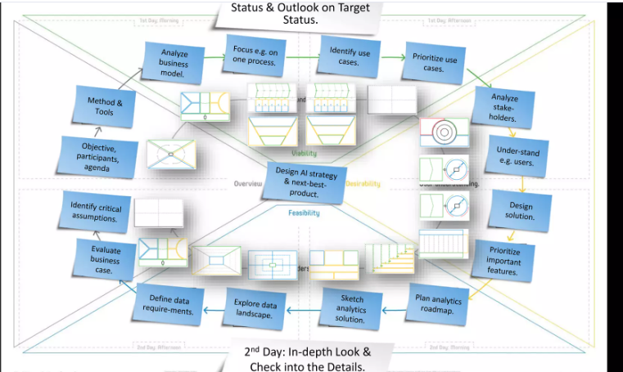

Slide 35
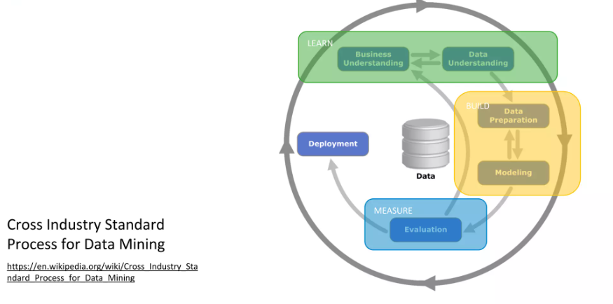

Slide 36
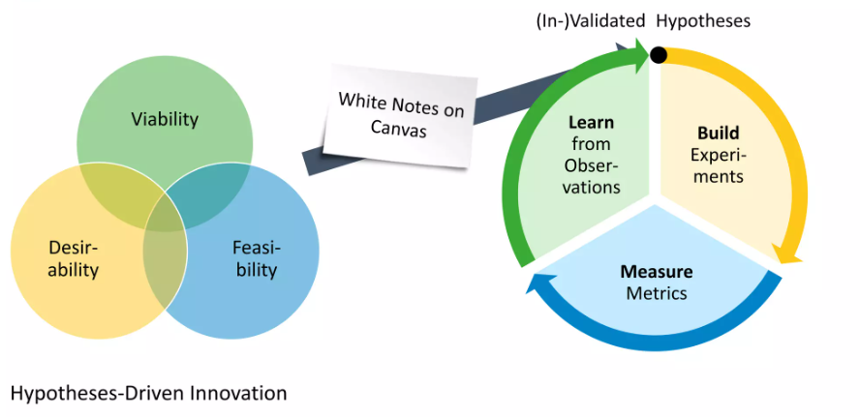

Slide 37
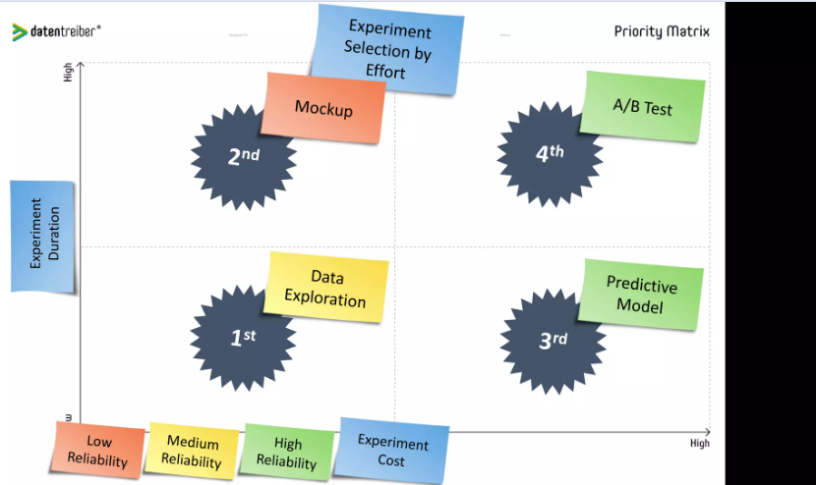

Slide 38
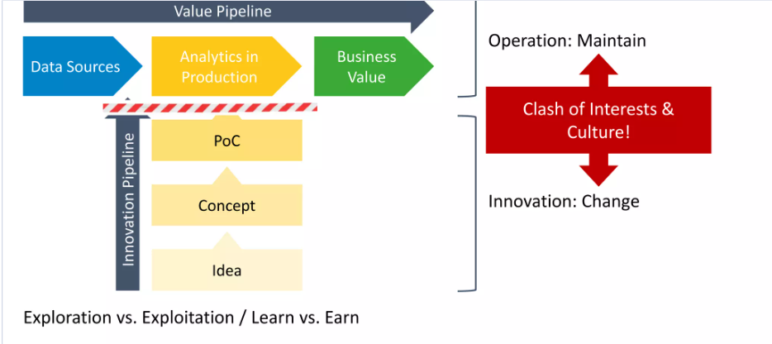

Slide 39
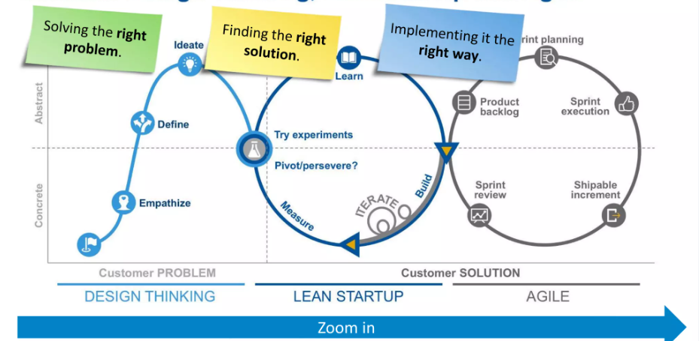

Slide 40
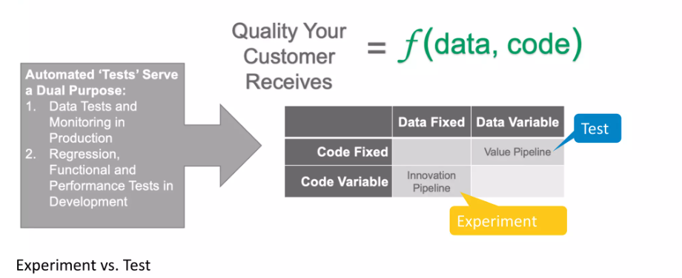

Slide 41
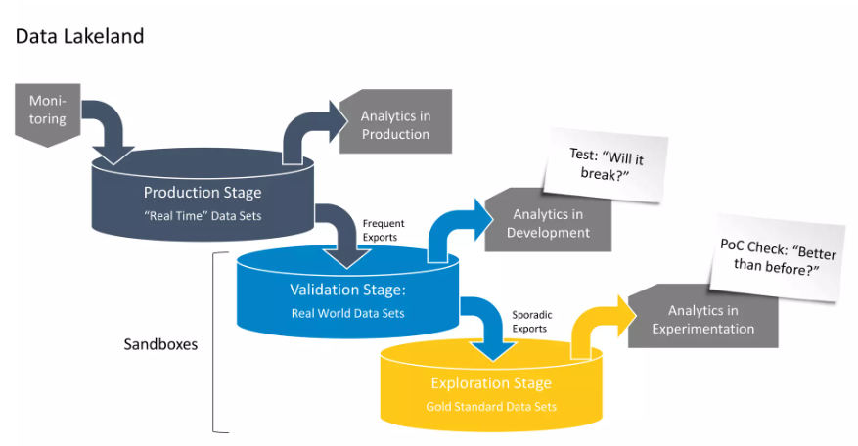

Slide 42
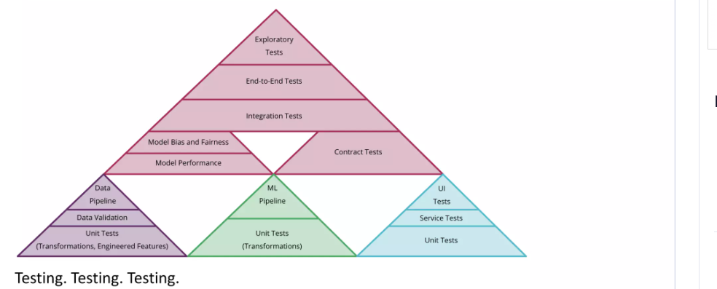

Slide 43
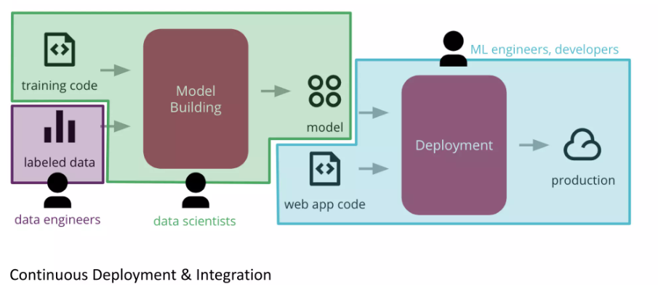

Slide 44
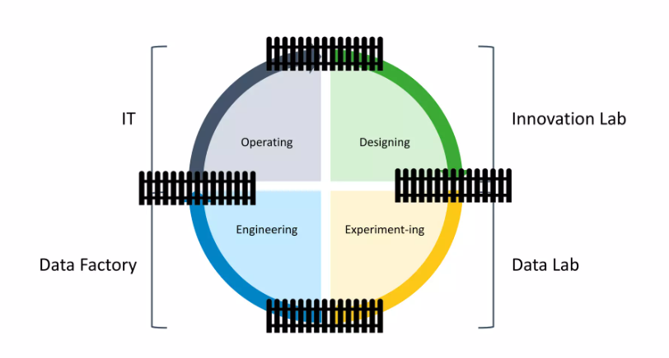

Slide 45
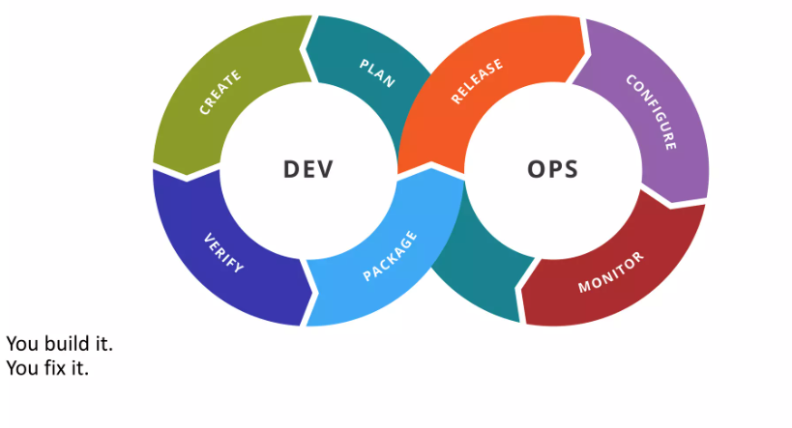

Slide 46
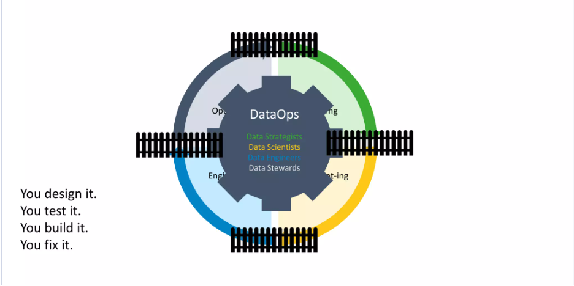

Slide 47
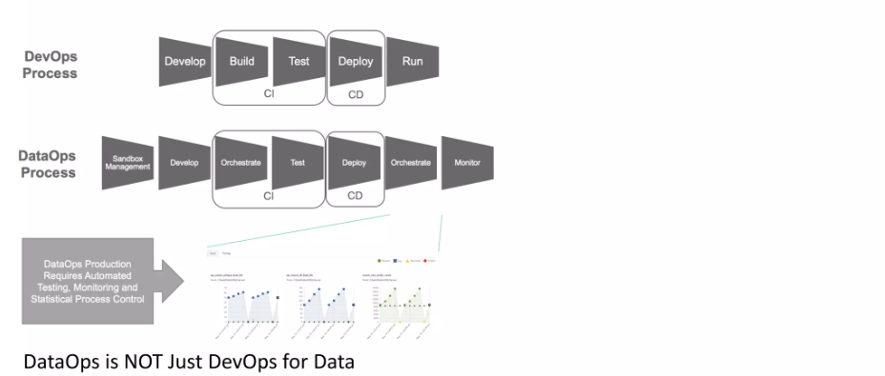

Slide 48
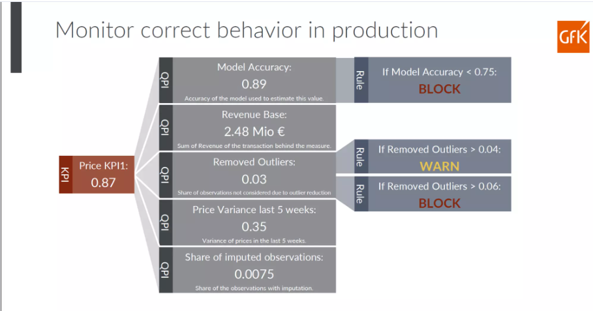

Slide 49
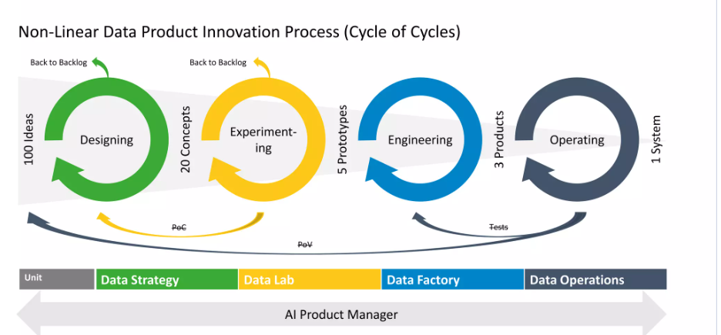

Slide 50
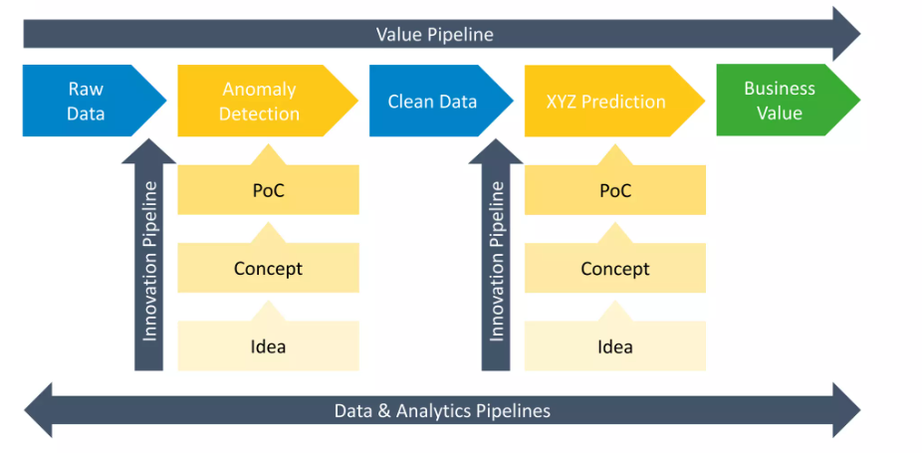

Slide 51
How AI and ML are changing software Product Management?

Slide 52
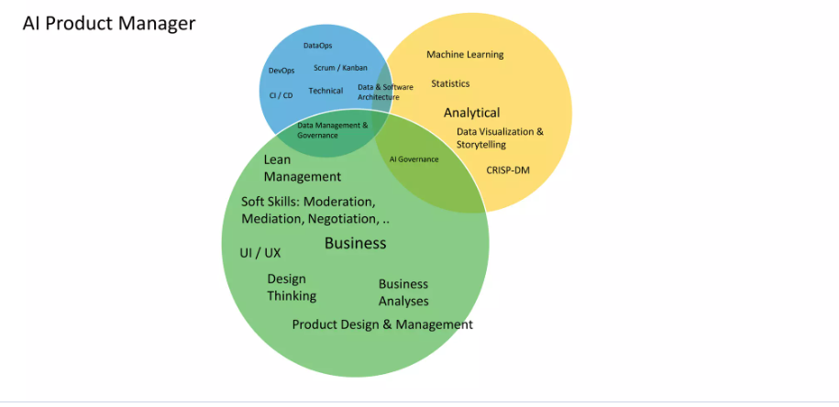

Slide 53
How to get AI as Product Manager

Slide 54
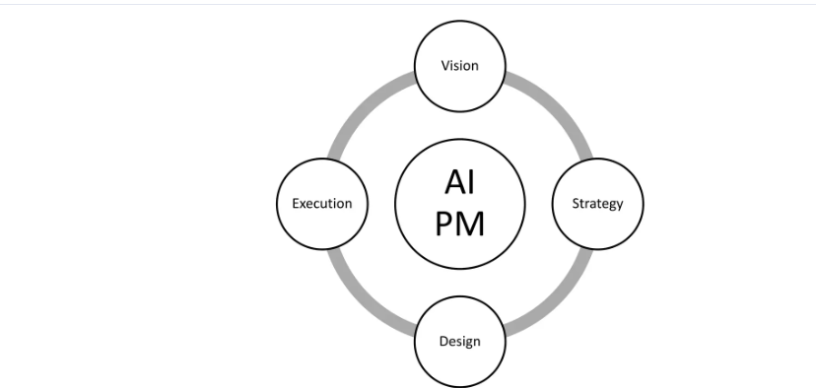

Slide 55
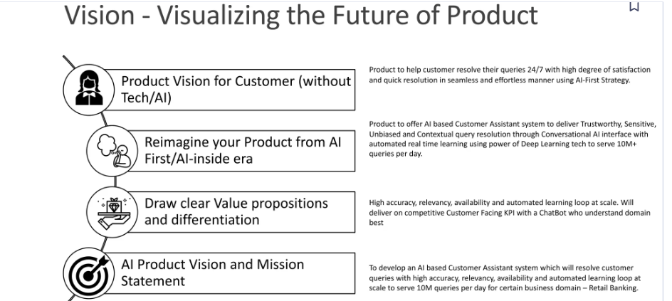

Slide 56
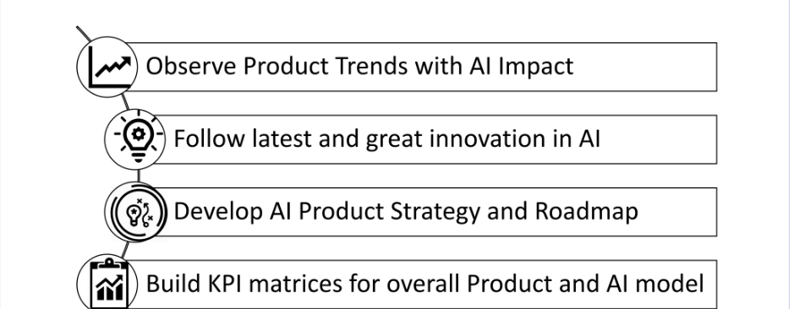

Slide 57
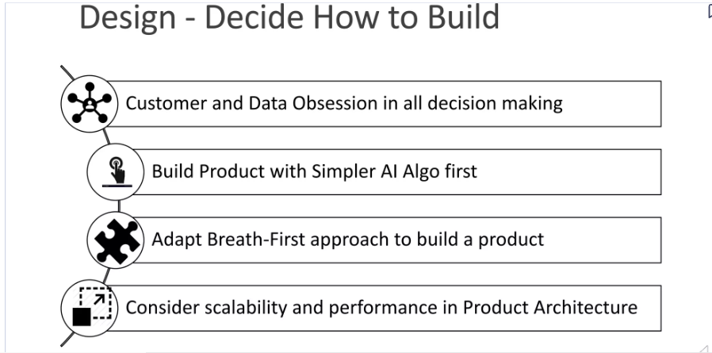

Slide 58
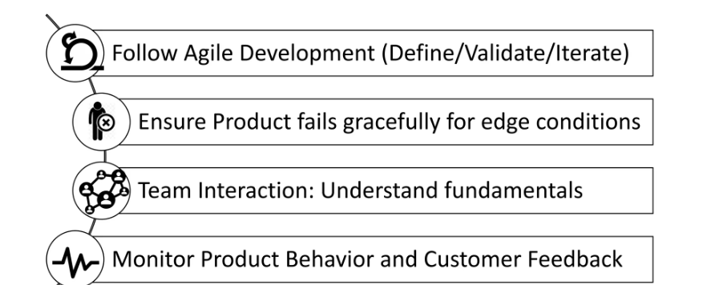

Slide 59
Barriers to AI Adoption and overcoming solutions

Slide 60
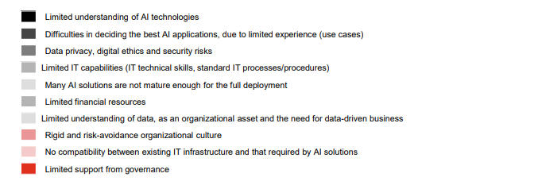

Slide 61


Slide 62


Slide 63


Slide 64


Slide 65


Slide 66




Slide 67



Slide 68


Slide 69



Slide 71
How to evaluate and Prioritize AI Projects?

Slide 72


Slide 74


Slide 75


Slide 76
Understanding the Infrastructure and Tools for Building AI Products

Slide 77
ML
All ML models can be grouped into the following four major learning categories:
Supervised learning
Unsupervised learning
Semi-supervised learning
Reinforcement learning

Slide 78
DL
This opacity is double-sided, both for the engineers and technologists themselves, as well as for the customers and users downstream who are experiencing the effects of these models without knowing how they make certain determinations.
The DL neural networks are mimicking the structure of the way humans are able to think using a variety of layers of neural networks.

Slide 79
The order – what is the optimal flow and where does every part of the process live?

Slide 80
Step 1 – Data availability and centralization
Step 2 – Continuous maintenance

Slide 81
B 101 – databases, warehouses, data lakes, and lakehouses
Managing projects – IaaS

Slide 82
Deployment strategies – what do we do with these outputs?
Shadow deployment strategy
A/B testing model deployment strategy
Canary deployment strategy

Slide 83
Succeeding in AI – how well-managed AI companies do infrastructure right

Slide 84
The promise of AI – where is AI taking us?

Slide 85
Model Development and Maintenance for AI Products

Slide 86
Model Development and Maintenance for AI Products
Understanding the stages of NPD Model types – from linear regression to neural networks Training –
when is a model ready for market?
Deployment – what happens after the workstation?
Testing and troubleshooting Refreshing – the ethics of how often we update our models

Slide 87
Understanding the stages of NPD
Step 1 – Discovery
Step 2 – Define
Step 3 – Design
Step 4 – Implementation
Step 5 – Marketing
Step 6 – Training
Step 7 – Launch

Slide 88


Slide 89
Deployment
To choose the best way to access the model (most often through an API or some UI/platform that’s currently being used by your end user)
To get a sense of how often it will be called
To determine how many GPUs/CPUs and how much memory it will need to run To figure out how it will be continuously fed data

Slide 90
Ethics
Respect for human autonomy:
Prevention of harm
Fairness
Explicability

Slide 91
Exploring DL
The input layer
The hidden layer(s)
The output layer

Slide 92
Types of NNs
Multilayer perceptrons (MLPs)
Radial basis function networks (RBFNs)
Convolutional neural networks (CNNs)
Recurrent neural networks (RNNs)
Long short-term memory networks (LSTMs)
Generative adversarial networks (GANs)
Self-organizing maps (SOMs) Deep belief networks (DBNs)

Slide 93
Commercializing AI Products

Slide 94
Commercializing AI Products
The professionals – examples of B2B products done right
The artists – examples of B2C products done right
The pioneers – examples of blue ocean products
The rebels – examples of red ocean products
The GOAT – examples of differentiated disruptive and dominant strategy products

Slide 95

Strategy Quadrant

Slide 96
AI Transformation and Its Impact on Product Management
Money and value – how AI could revolutionize our economic systems
Goods and services – growth in commercial MVPs
Government and autonomy – how AI will shape our borders and freedom
Sickness and health – the benefits of AI and nanotech across healthcare
Basic needs – AI for Good

Slide 97
Understanding the AI-Native Product
Stages of AI product development AI/ML product dream team
Investing in your tech stack (further expanding on concepts from the preceding infrastructure section)
Productizing AI-powered outputs—how AI product management is different
Customization for groups—considerations for verticals and customer groupings
Selling AI—product management as a higher octave of sales

Slide 98
Stages of AI product development
Phase 1 – Ideation
Phase 2 – Data management
Phase 3 – Research and development
Phase 4 – Deployment

Slide 99
AIML Dream team
AI PM
AI/ML/data strategists
Data engineer
Data analyst
Data scientist and ML engineer
Frontend/backend/full stack engineers
UX designers/researchers

Slide 100
go-to-market (GTM)
Terminology about your product
How you’re going to position it in the market
How much of your proprietary tech and algorithmic magic you’re going to allow your salesforce to discuss with potential customers on demos How much explainability you’re going to offer
How you’re going to communicate about technical decisions you’ve made about your product
How much information about your product you’re going to shield from the world in the spirit of competition

Slide 101
Investing in your tech stack
Productizing AI-powered outputs – how AI product management is different
AI customization
Selling AI – product management as a higher octave of sales
Understanding the differences between AI and traditional software products

Slide 102
B2B versus B2C – productizing business models
Domain knowledge – understanding the needs of your market
Experimentation – discover the needs of your collective
Performance evaluation – testing, retraining, and hyperparameter tuning
Feedback loop – relationship building

Slide 103
Customization for Verticals, Customers, and Peer Groups
Understanding domain spaces and how AI can be optimized for these domains
Fluency with various verticals that are seeing a high saturation of AI products
Understanding user behavior analytics
Optimizing value metrics for AI products
Learning from peers in your space through thought leadership and consultancy

Slide 104
Domains – orienting AI toward specific areas
Leaders
Challengers
Visionaries
Niche players

Slide 105
Understanding your market
Understanding how your product design will serve your market
Building your AI product strategy

